Slide 1
The Introduction of RobotSDK
A Top-down Modular Software Development Framework
一种自顶向下的模块化软件开发框架
HMW-Alexander
何梦文

Slide 2
报告大纲
什么是RobotSDK
启发与理念
基本概念
开放框架与架构
RobotSDK的发展历史
北京大学期间
名古屋大学期间
RobotSDK的开发计划
卡耐基梅隆大学期间
开源开发计划

Slide 3

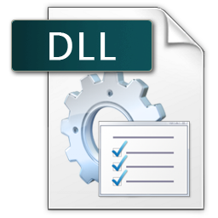


基于抽象图模型的
高层程序设计与实现
Qt-Based
动态库封装功能模块
自由嵌入高层程序

Slide 4
High-Level Abstract Software
Viewer
Sensor
Processor
Logger
Low-Level Functional Modules
Shared Library
Shared Library
Shared Library
Camera
LiDAR
Encoder/IMU
High Pass Filter
Denoise
Dead-Reckoning
Image Viewer
Range Viewer
Trajectory Viewer
Recorder
Range Logger
Trajectory Logger

Slide 5
Kernel Development
Application Development
Graph
Model
High-level
Application
RobotSDK
Generate a Shell
Automatically
Interface
Protocol
Explicitly
Link
Shell
Shell Interfaces
Algorithms
Compile
Packed Algorithm
to Shared Library
Algorithm I/O & Call
Shared Library Development

